Slide 1
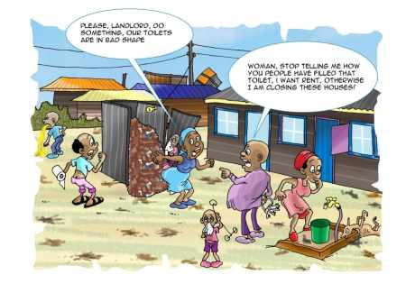
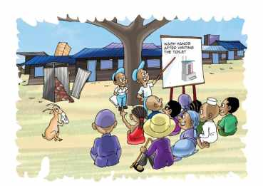
Water Sector Trust Fund SOCIAL MARKETING
Social Marketing: Target Groups
people, place, product, price, participation, promotion, policy, programs, positioning, partnerships, poo, pee

Slide 2
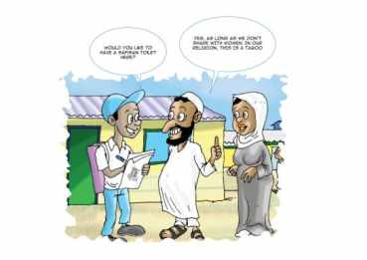
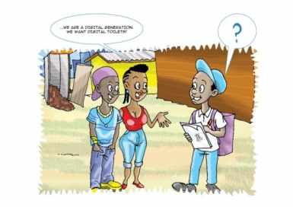
UBSUP Social marketing: The target groups
The following groups/categories will be given special attention:
Householders
Landlords & landladies (rights and responsibilities)
Tenants (sanitation is a human right)
Women
Children (School wash)
“There is no such thing as selling to the general public” (Boffin, 2001; 58)

Slide 3
UBSUP Social marketing: 6 key messages
Access to adequate sanitation is a human right
Benefits of improved sanitation (better toilets)
Advantages of the SafiSan toilets
Importance of using the toilet properly, keeping the toilet clean and in good condition
Importance of hand washing especially after using the toilet (to kill germs & reduce the risk of diseases)
Importance of emptying, transport & decentralised treatment (if applicable)

Slide 4
Different message for different target groups
As a social Animators, it is key to ensure that the organization and the implementation of the following key awareness creation and social marketing activities is carried out:
Community awareness creation and mobilization
Public meetings (barazas) and SafiSan baraza shows
Involving local opinion leaders and focal people in the community
SafiSan mini fairs
Household and plot level social marketing sessions
Data collection and data transfer to the WSP- with the use of the tablets given

Slide 5
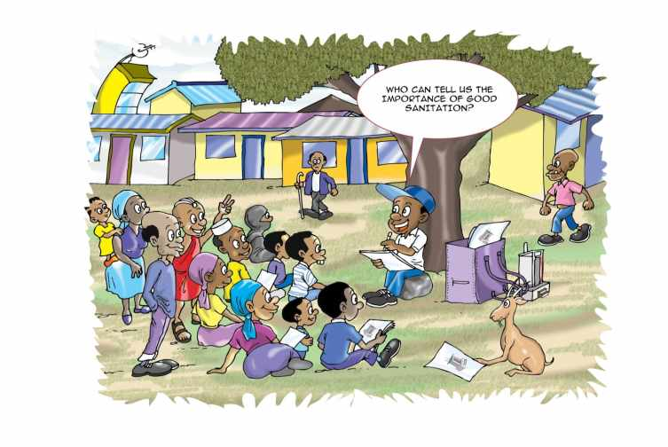
Thank You!

